Slide 1


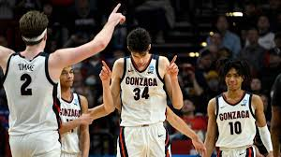

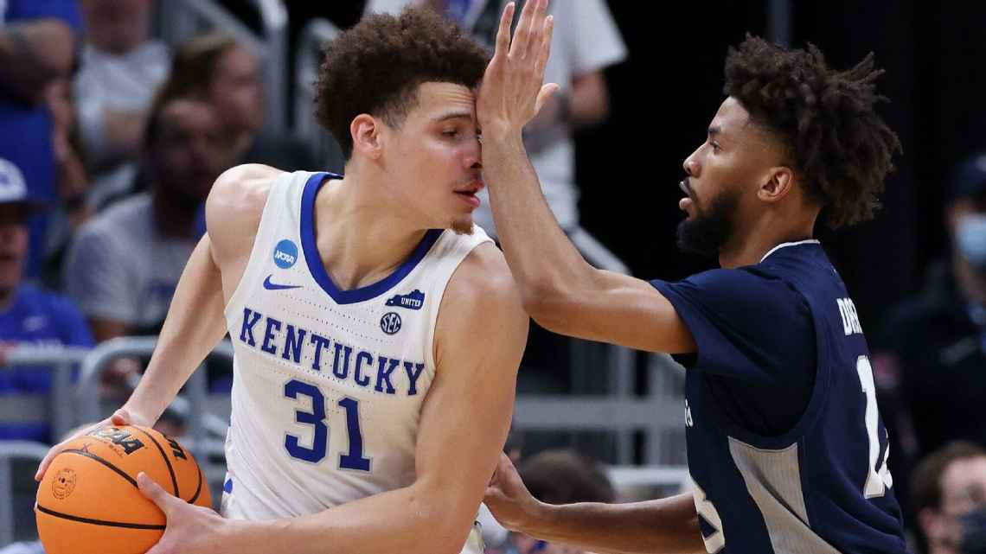
2022
March Madness:
NCAA Men’s Tournament Bids Report
Presented by
Goal Diggers
-Nancy Wang
-Stephanie Zhao
-Tony Wang
-Vandana Agarwal

Slide 2

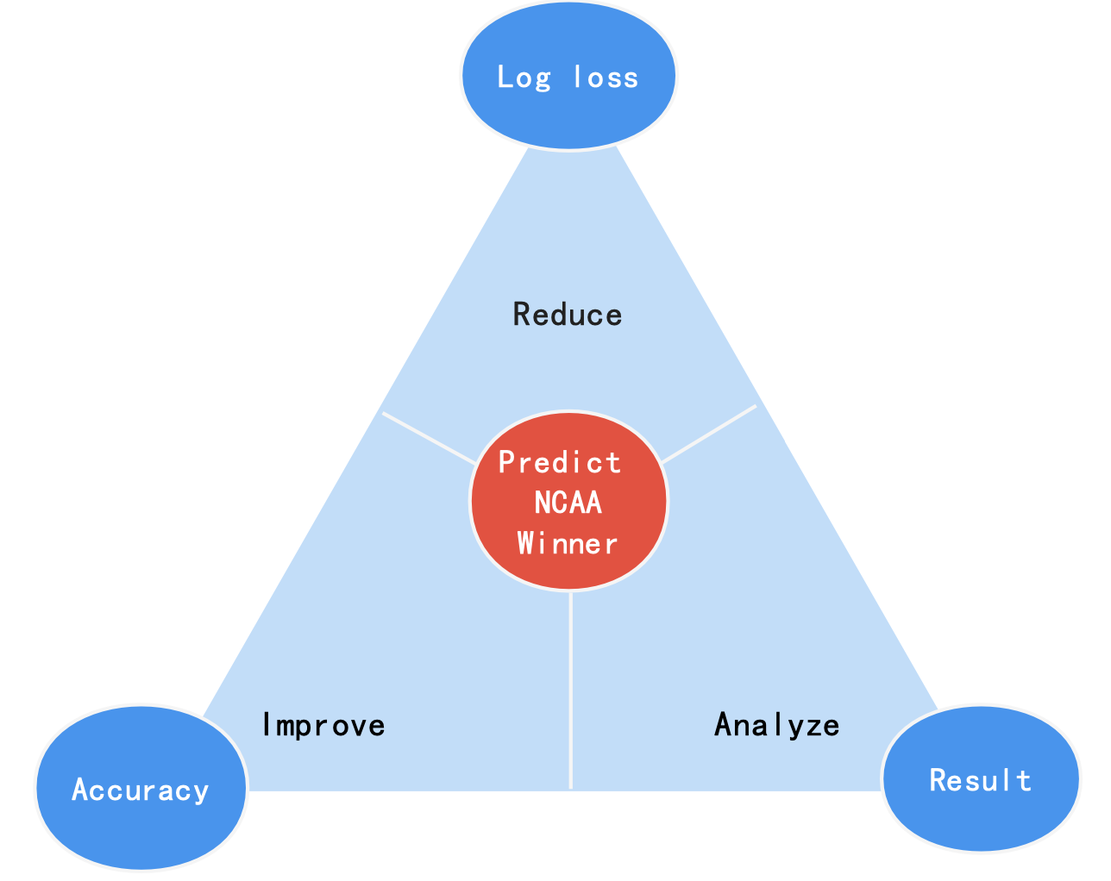
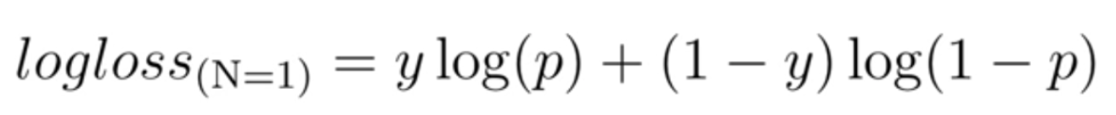

What are we supposed to e?
Objectives
We predict NCAA winner with following objectives:
1. Reduce log loss
2. Improve accuracy
3. Analyze result

Slide 3

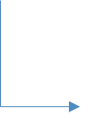
Hypotheses
The team’s seed number has a great impact in their probability of winning because a higher seeding means a weaker opponent and a home court advantage
Offensive Rebounds Off, Defense Rebounds Def, Tempo Factors play an equally important role in each game outcomes
We ignore the impact of athlete turnover due to graduation on the level of the team Predictors will remain sustainable in the foreseeable future.

Slide 4

Challenges
Our dataset has 104 features, and determining the impact of these features on the outcome of each match may be a complex process
All the observations share the same result (team1 wins) which will not satisfy the rule of model training part
A single model may lead to some errors in the results due to its limitations so that we need to build an ensemble model to improve the accuracy of our prediction

Slide 5
Methodology
Single Model
(Logistic Regression
Random Forest
Gradient Boosting
Deep Neural Network)
Ensemble Model
Data Preprocessing
Feature selection
Model Building
Conclusion & Improvement
Model Evaluation
Data Exploration
Relevance Detection
Swap/Transfer Data
Add Dependent Variable['result']
Institutional knowledge
Random Forest Algorithm
Accurancy
Log Loss

Slide 6
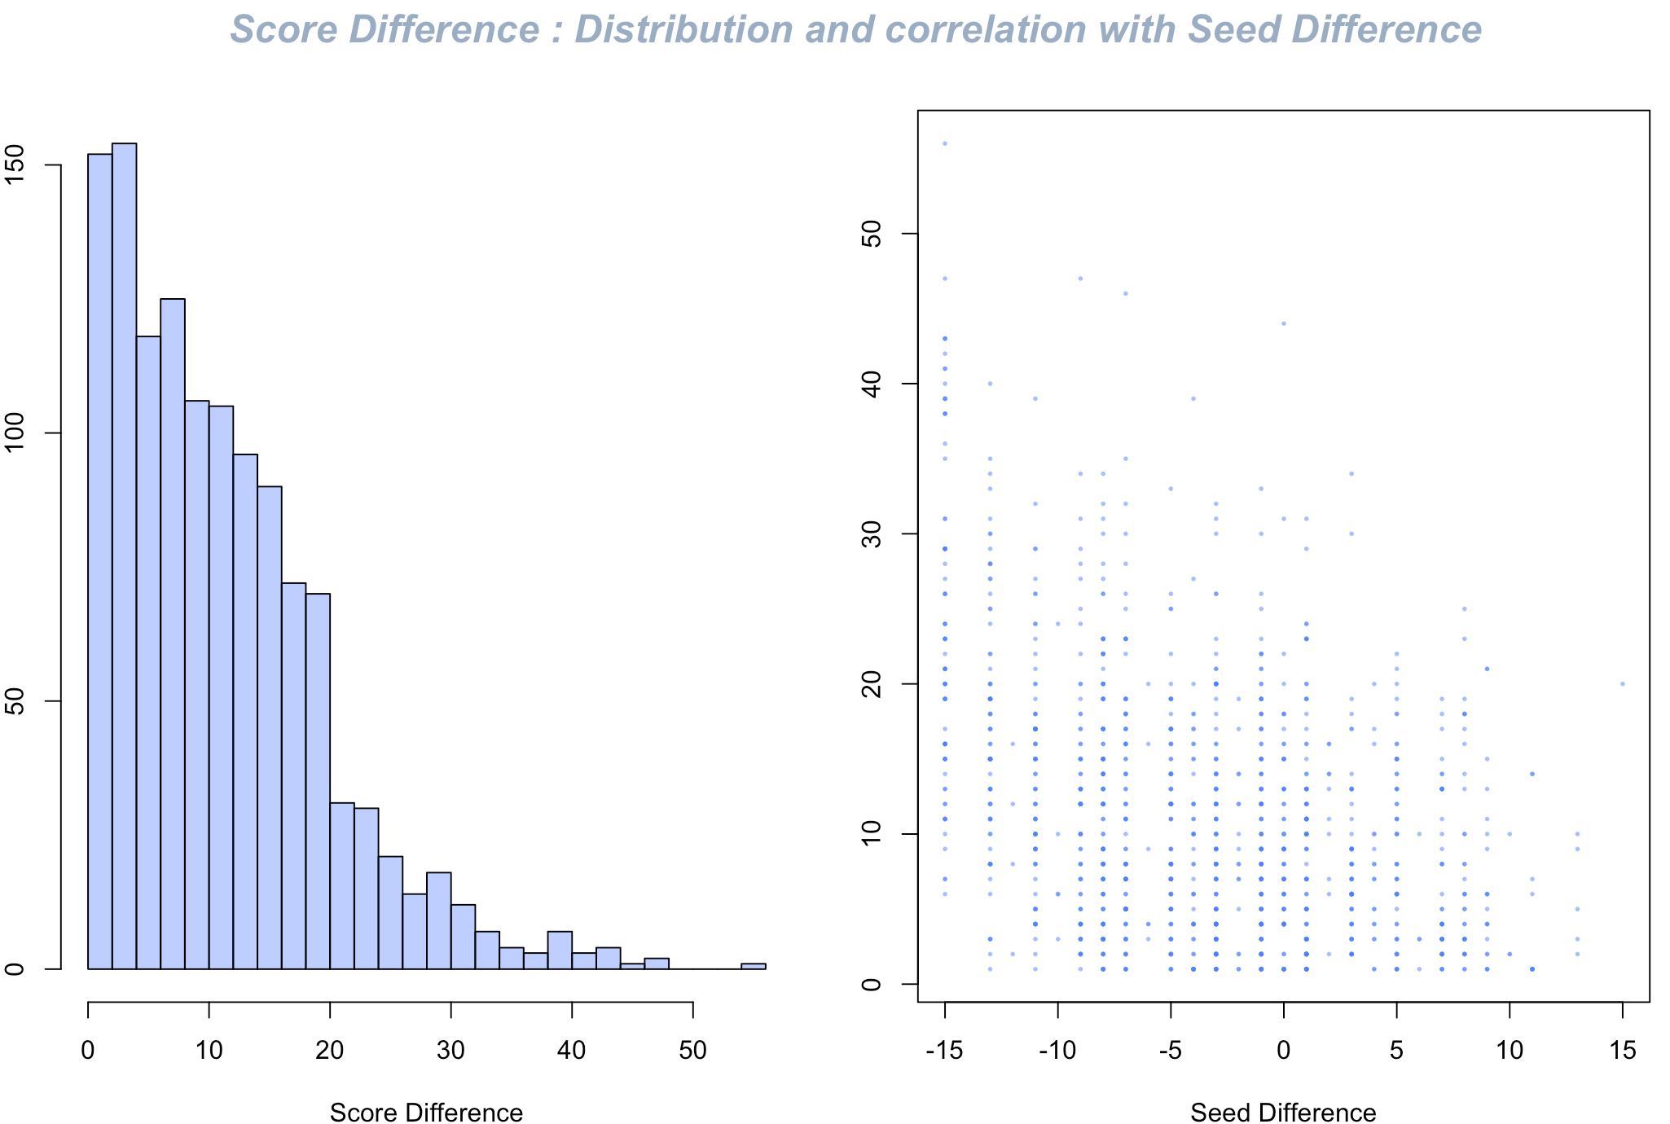
Data Exploratory
Findings:
Score difference shows exponential distribution
The score difference tends to be large when the seed difference is large negative
* Definition:
Score difference = team1 score – team2 score
Seed difference = team1 seed – team2 seed

Slide 7
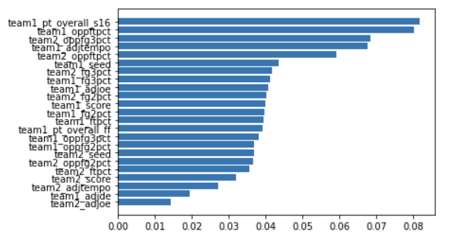
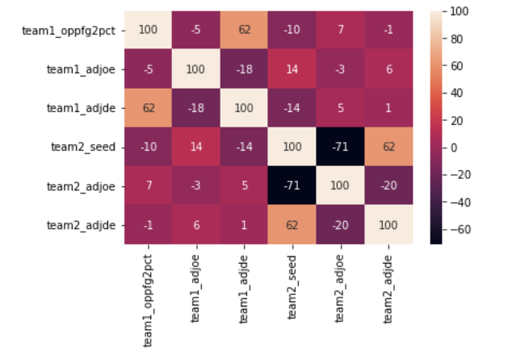
Feature Selection
Institutional
Knowledge
Random Forest
cut_off = 0.05
104 Features
24 Features
6 Features
'team1_oppfg2pct', 'team1_adjoe', 'team1_adjde', 'team2_seed', 'team2_adjoe', 'team2_adjde'

Slide 8



Single Model Comparison
Model | Accuracy | Log Loss | Efficiency(high/modest/low)
Logistic Regression | 0.7112 | 0.5641 | HIGH
Deep Neural Network | 0.6789 | 0.5527 | HIGH
Random Forest | 0.7005 | 0.6268 | MODERATE
Gradient Boosting | 0.6658 | 0.6618 | MODERATE
K-Nearest Neighbor | 0.7032 | 0.7316 | LOW
Highest Model Performance
Deep Neural Network
ACCURACY
67%
LOG LOSS
0.55

Slide 9

Model Building - Ensemble
Logistic Regression
Mean
Ensemble Model
(LR+RF+GB+DNN)/4
Gradient Boosting
ACCURACY​
71%
Log Loss
0.591​
Random Forest
Deep Neural Network
logistic regression
Random Forest
DNN
Gradient Boosting
这四种model combine求平均
Accurrency/Log loss分别是多少 做表

Slide 10
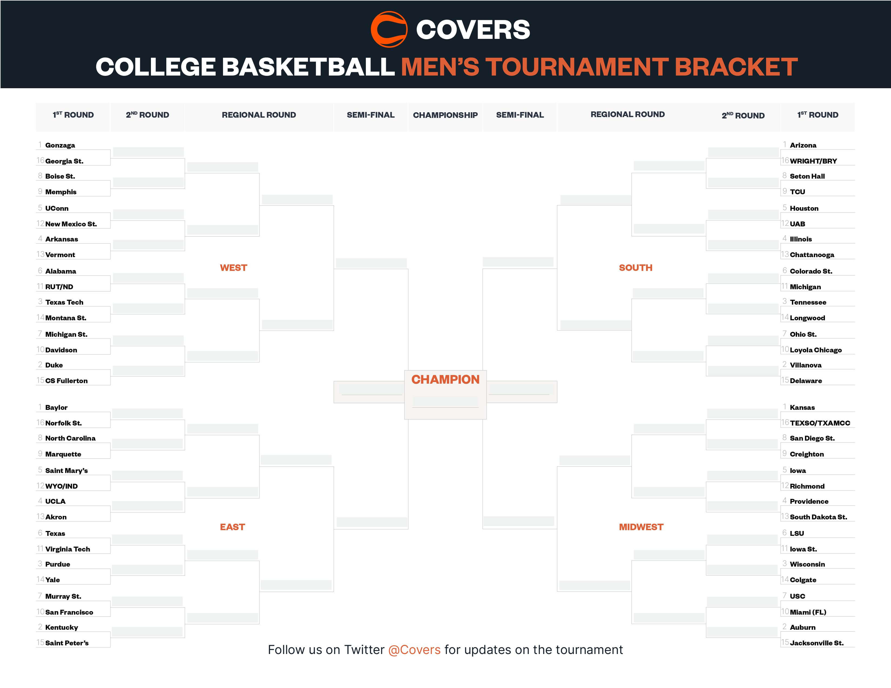


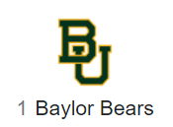

Date by
March 23
Gonzaga
Arizona
Gonzaga
Arizona
Boise St
Seton Hall
Gonzaga
Arizona
Connecticut
Houston
Connecticut
Houston
Arkansas
Illinois
Alabama
Gonzaga
Arizona
Colorado St
Alabama
Colorado St
Texas Tech
Tennessee
Alabama
Loyola-Chicago
Michigan St
Loyola-Chicago
Duke
Loyola-Chicago
Duke
Villanova
Gonzaga
Arizona
Baylor
Gonzaga
Kansas
Baylor
Kansas
North Carolina
San Diego St
Baylor
Kansas
St Mary's CA
Iowa
Iowa
St Mary's CA
Correct
Prediction
Providence
UCLA
Baylor
Kansas
Providence
Incorrect
Prediction
Texas
LSU
Texas
Wisconsin
Purdue
Texas
Wisconsin
Predicted
Top 8 Teams
Auburn
San Francisco
USC
San Francisco
Auburn
Kentucky
Auburn

Slide 11
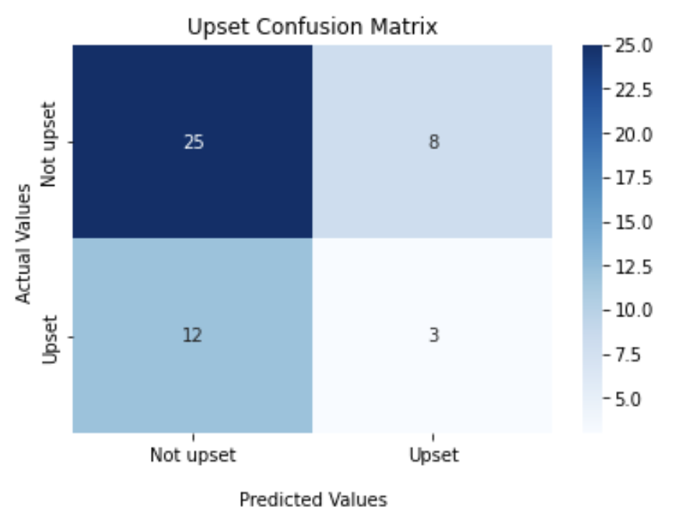


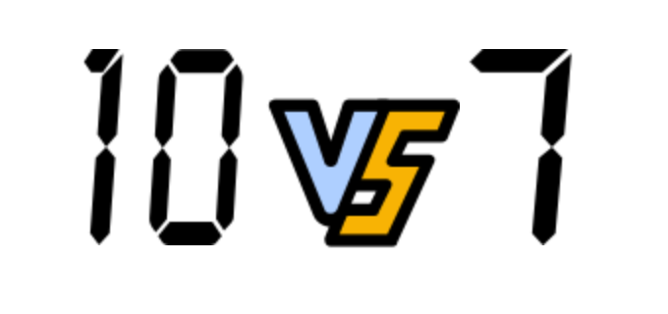
Final 4 Conclusion
Champion Probability Prediction
Upset Prediction
89.71%
89.89%
Recall | Precision
0.20 | 0.27
54.10%
36.06%
PREDICTED FIRST ROUND UPSETS
San Francisco 51.63% | Loyola 53.57%

Slide 12
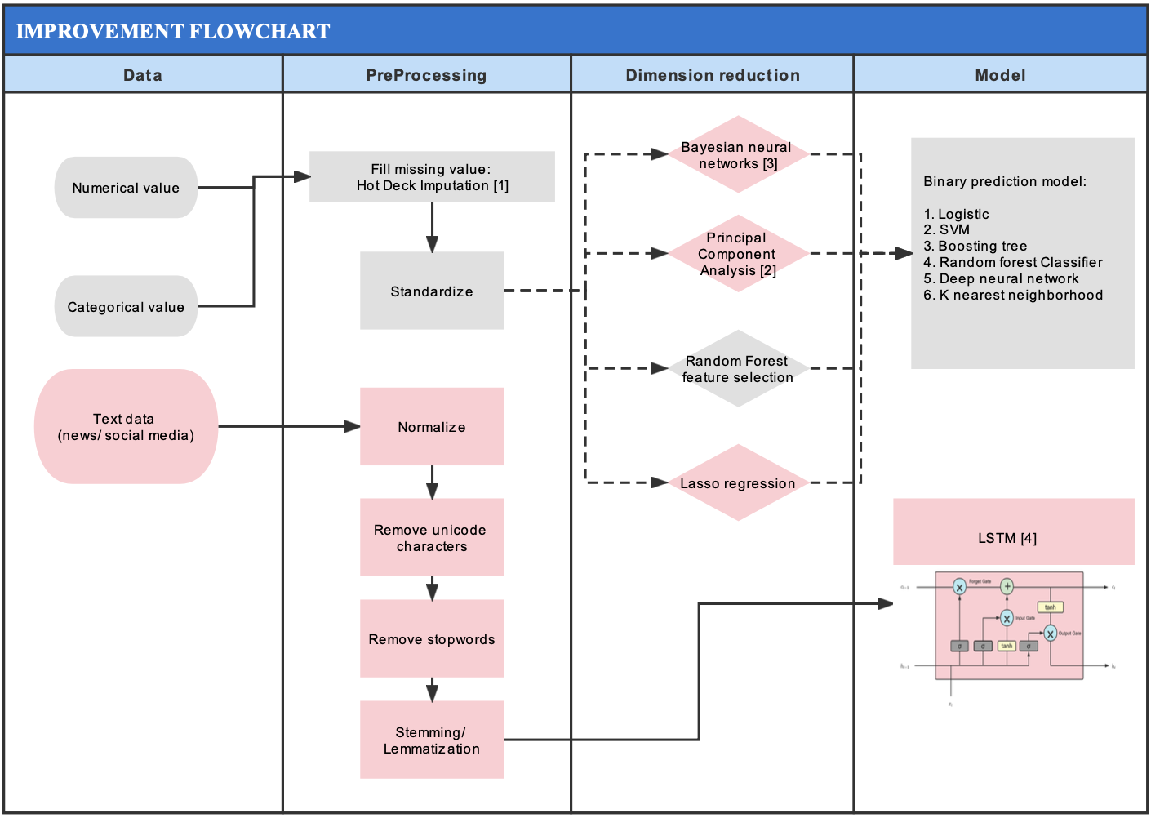
Improvement
What we have done
What can be improved

Slide 13
[1] Andridge, R. R., & Little, R. J. (2010). A review of hot deck imputation for survey non‐response. International statistical review, 78(1), 40-64. [2] Abdi, H., & Williams, L. J. (2010). Principal component analysis. Wiley interdisciplinary reviews: computational statistics, 2(4), 433-459. [3] Carreira-Perpinán, M. A. (1997). A review of dimension reduction techniques. Department of Computer Science. University of Sheffield. Tech. Rep. CS-96-09, 9, 1-69. [4] Yao, L., & Guan, Y. (2018, December). An improved LSTM structure for natural language processing. In 2018 IEEE International Conference of Safety Produce Informatization (IICSPI) (pp. 565-569). IEEE. [5] https://en.wikipedia.org/wiki/NCAA_Division_I_Men%27s_Basketball_Tournament
Reference

